Slide 1

Stakeholder Meeting
Clinton Parking Study
November 29, 2023
Notes:
Hello. My name is Gordon Hui and I am a senior transportation planner and engineer for the municipal transportation planning team at R.J. Burnside & Associates. I am also the project manager for this parking study. We recognize that Clinton is experiencing similar challenges to downtowns in other municipalities related to increasing growth to the area, population intensification, but we also recognize that the Clinton is its own unique location and destination within Ontario. We recognize that it’s a highly sought after tourist destination, filled with many local businesses, and directly adjacent to the shores of Lake Huron. We recognize that although parking challenges are similar to other municipalities, we have been working with Municipal staff to ensure that this parking strategy is unique and tailor-made to the Municipality itself.

Slide 2


Project Team
Central Huron
R.J. Burnside & Associates Ltd.
Steve Doherty
CAO
Anne-Marie Thomson
Planning Coordinator
Brady Nolan
Roads Manager
Rachel Anstett
Clerk
Jillian Bjelan
Executive Assistant
Gordon Hui
Consultant Project Manager
Mishaal Rizwan
Consultation Lead
Notes:
The project team consists of a variety of Municipal staff and staff from R.J. Burnside & Associates.

Slide 3
Outline
1
Study Purpose
2
Overview of Phase 1 and 2
3
Data Collection
4
Parking Management Components
5
What We’ve Heard
6
Next Steps
Notes:
Today I will be discussion the study purpose, the study scope which consists of Phase 1 and Phase 2, data collection, parking management components that we are reviewing, what we’ve heard so far, and our next steps.

Slide 4
Study Purpose
Address existing and anticipated parking issues and leverage opportunities to enhance their parking management system, which includes infrastructure, policies, and programs.
The study will help develop a strategy that will meet parking demands while supporting:
  The public realm,
  Economic development,
  Accessibility.
Notes:
The purpose of this study is to understand the parking issues that currently exist or are anticipated to exist in Clinton and develop a parking management framework that addresses those issues.
The study intends on addressing challenges while supporting the Town’s objectives such as the creating an attractive public realm, supporting economic development, and enhancing accessibility.

Slide 5
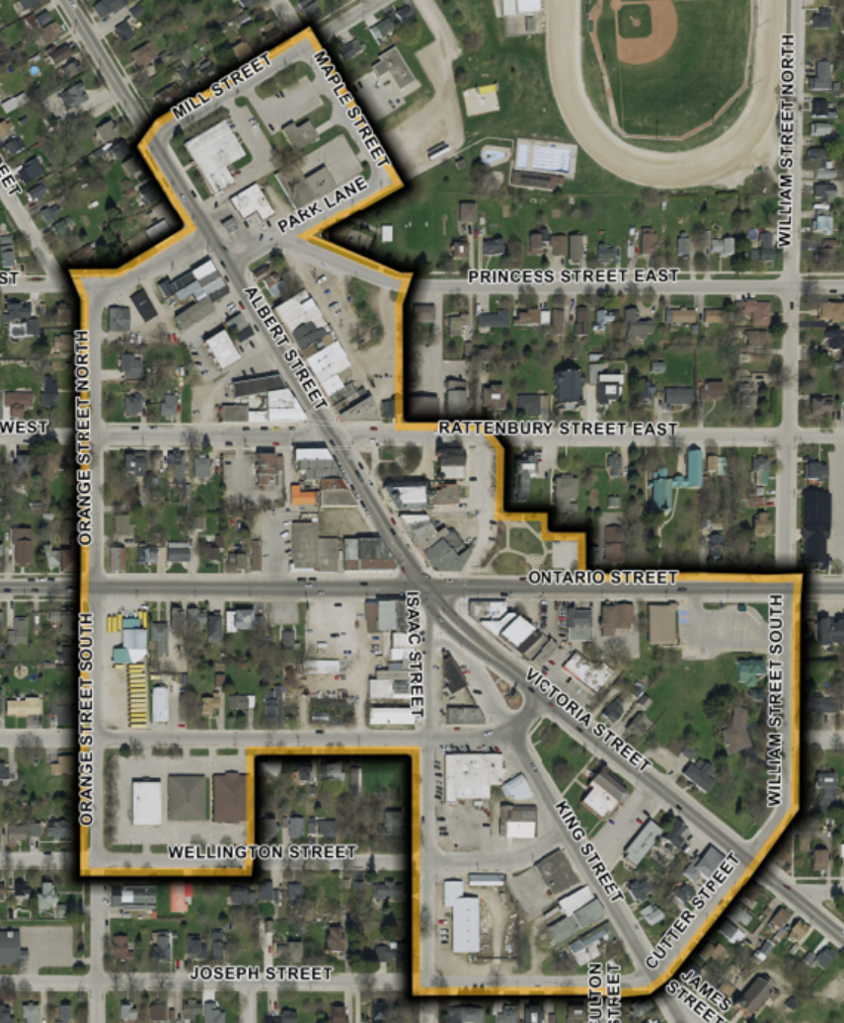
Study Area (Clinton BIA)
Notes:
The study area is within and in close vicinity to the Clinton Business Improvement Area district shown on the figure on this slide.

Slide 6
Overview of Phase 1 and 2
Notes:
I will now provide an overview of Phase 1 and Phase 2 of this study.

Slide 7



Overview of Phase 1 – Parking Needs and Issues
Data Collection
Consultation
Needs/Opportunities Assessment
Parking utilization studies
2 surveys, business outreach, open house
Parking needs/opportunities for residents
Parking needs/opportunities for businesses
Notes:
The goal of the first phase is to collect parking-related data within the area. This will provide an understanding of when people are parking and the level of parking demand within the area. Concurrently, we will be engaging residents, businesses, and any stakeholders within the Municipality. Based on the data collected and the engagement, we will have an understanding of the parking issues and challenges that Clinton currently faces. Later in the presentation, I will provide you with some ways you can be engaged.

Slide 8


Overview of Phase 2 – Develop Strategy
Best practice reviews
Literature review
Identify Draft Solutions
Residential parking permits
Develop Parking Management Strategy
Jurisdiction scan
Policies
Additional infrastructure
Notes:
The next phase is taking those issues that we have identified, seeing what other comparable jurisdictions have done, and based on our assessment, experience, and understanding, we will develop a range of possible solutions which can involve policies or infrastructure improvements. Those final solutions will form the parking management framework.

Slide 9
Data Collection
Notes:
I will not provide a brief summary of the data that will be collected.

Slide 10
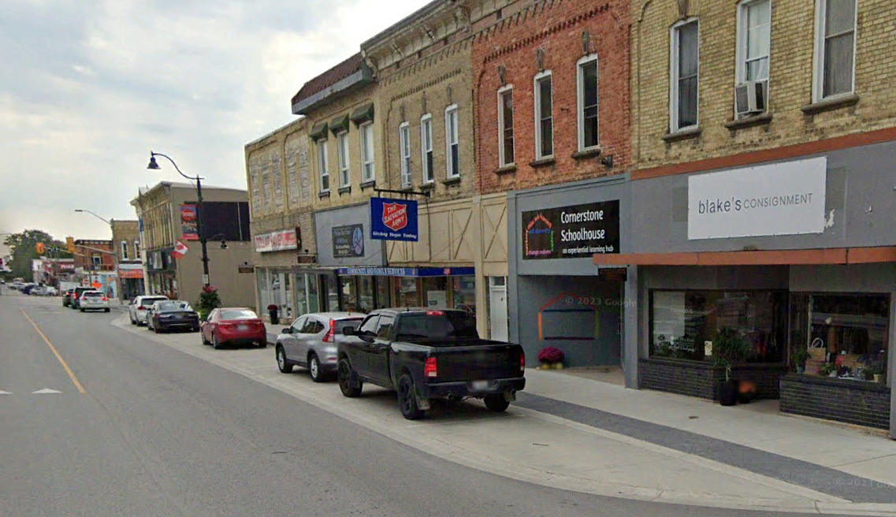
Data Collection
The project team is collecting both parking utilization and turnover data
  Utilization: Percentage of the number of occupied parking spaces at any given time during the day.
  Turnover: Estimated number of vehicles that use each parking stall throughout a period of time. Inverse of the parking duration
Notes:
The two types of data we are collecting includes parking utilization and turnover. Utilization refers to the percentage of the spaces that is occupied by parked vehicles at any give time.
Turnover is the number of vehicles that use each park stall throughout a period of time. So in other words, the more vehicles that use a particular parking spot during the day, the shorter the average parking duration.

Slide 11
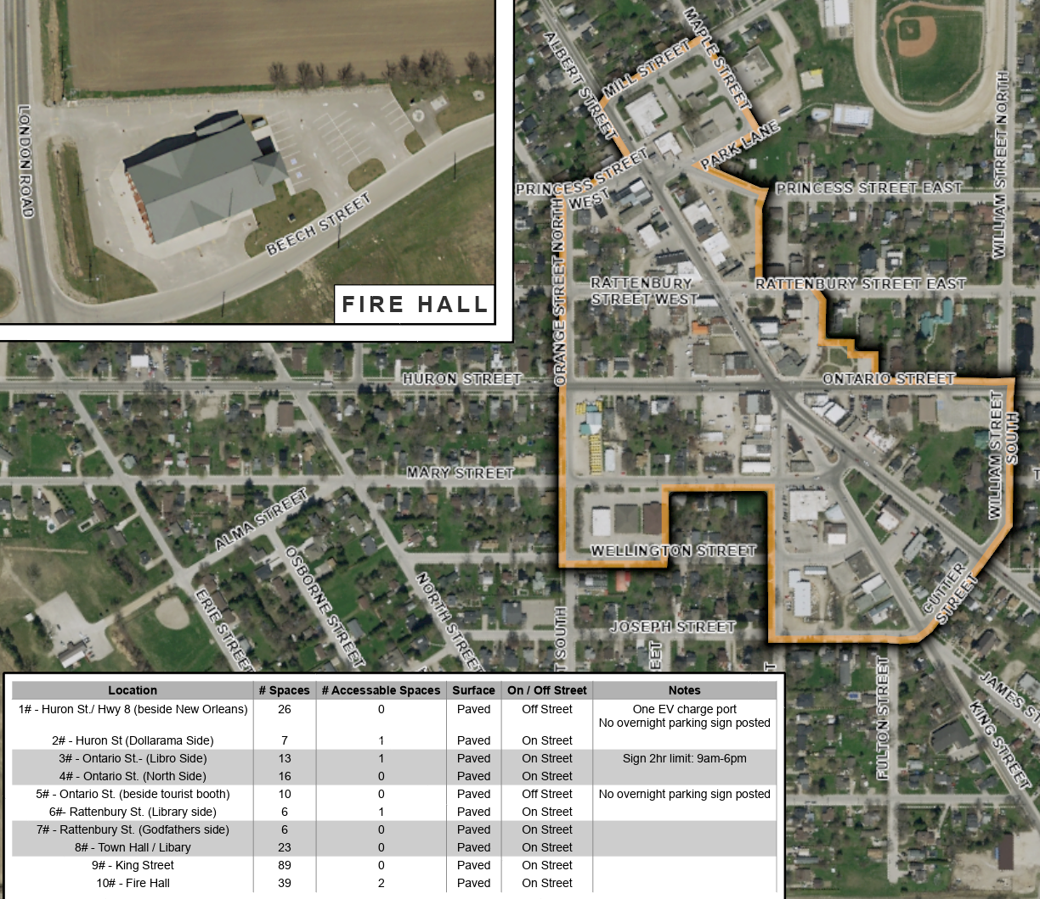
Data Collection
Data collection details:
Data will be collected from 9 AM to 6 PM
Frequency will be every hour
Purpose is to understand how high the parking demand is and when that demand is occurring throughout the day
Notes:
Utilization data will be collected along the streets and areas highlighted in red between 9 AM to 6 PM. Turnover or duration data will be collected in the areas and streets highlighted in yellow. The purpose is to understand how high the parking demand is and when that demand is occurring throughout the day.

Slide 12
Parking Management Components
Notes:
The next few slides show some of the components of the parking management system that we will be exploring.

Slide 13
Parking for All Users
There is competition for parking spaces in Clinton for many types of users:
  Visitors
  Employees
  Residents
Each parking user has its own unique set of needs and wants
  E.g., Visitors often want close and convenient parking, employees require long-term parking throughout the day, residents want to be able to park overnight
Notes:
The most common challenge for downtowns like Clinton are that there are many different types of parking users competing for the same spots. For example, there are visitors or tourists to the areas, employees of businesses adjacent to the main streets, and residents who live close by or live on top of the first floor all need parking. All these parking users may, to some degree, rely on the municipal parking supply. They each have their own unique set of needs and wants. For example, visitors often want close and convenient parking, employees require long-term parking throughout the day, and residents want to be able to park overnight.

Slide 14
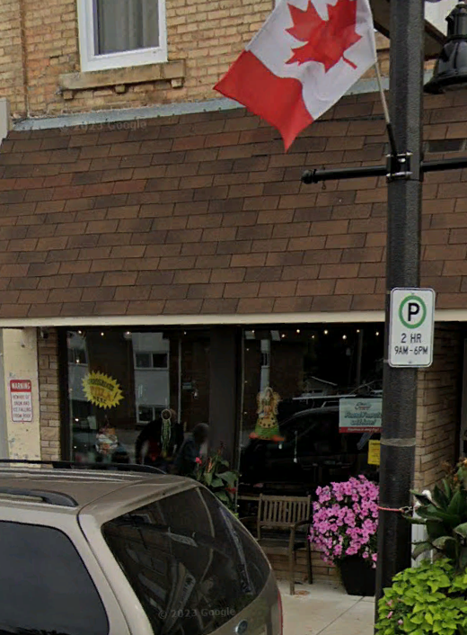
Parking Duration Limits
The parking by-law states maximum on-street parking duration limits.
There are currently no off-street parking duration limits.
The study is exploring how suitable these parking limits are. Balancing the following objectives:
  Providing adequate time to users
  Optimal use of the existing parking supply
Notes:
To assist in the development of the parking framework, we will be looking into the parking duration limits. The parking by-law defines these limits. Much of the downtown area has 2 hour parking limits from 8 AM to 6 PM. There are currently no off-street parking duration limits. The study will be exploring appropriate parking limits that can balance adequate time for users while optimizing the use of the existing parking supply.

Slide 15
Use of Programs, On-Street Spaces, and Parking Lot Infrastructure
Develop a strategy and implementation plan that considers:
How to best leverage both the on-street spaces and parking lots to provide for all users
Programs such as residential parking permits that allow residents to park overnight in certain locations
Additional spaces to be used for paved parking with marked stalls
Notes:
This study will also develop a strategy and implementation plan that considers how to best leverage both on-street spaces and parking lots to provide for all users. We will be exploring how programs such as residential parking permits allow residents to park overnight in certain locations. We will be exploring opportunities for additional spaces to be used for paved parking with marked stalls.

Slide 16
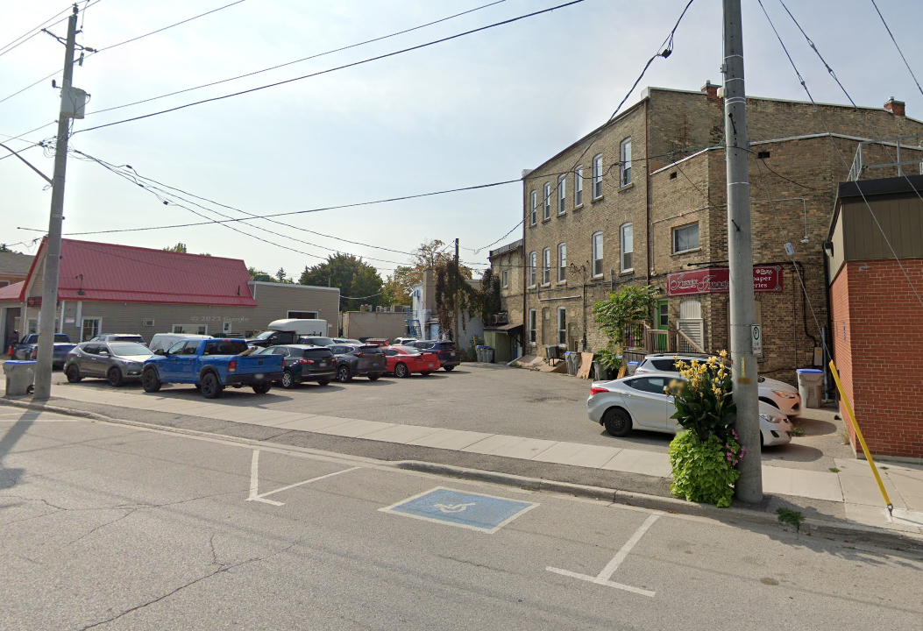
Accessibility
This study is exploring how parking can support visitors who have mobility constraints
  Limit the barriers between where they park and where they want to visit
Notes:
We will also be exploring accessibility needs for those with mobility constraints. We want to ensure that there are no barriers between where users park and where they want to visit.

Slide 17
What We’ve Heard So Far
Notes:
This section discusses what we’ve heard so far in our surveys.

Slide 18

Survey Details
Survey QR Code
Two surveys were hosted on centralhuron.ca
  Employer/Employee
  Residents
Advertised through social media, mailouts to residents, and e-mails to businesses through the BIA
Opened November 2, 2023
Survey open now
Received 223 responses to-date
  186 from residents
  37 from employer/employees
Survey URL
https://tinyurl.com/DowntownClintonParkingStudy
Notes:
Two surveys are currently hosted on centralhuron.ca. One is targeted towards employers and employees and one for residents. They were advertised through social media, mailouts to residents, and emails to businesses through the BIA. The surveys opened on November 2, 2023 and we have received 223 responses to date which consists of186 from residents and 37 from employer/employees.
The survey is still open and we would love to hear your input. You can use the following link: tinyurl.com/DowntownClintonParking Study or scan the QR code on the right of this slide.

Slide 19
Resident Survey
Planned Street Closures
Top Issues
Vehicles are parked all day
Not enough parking available
No parking for residents who live in the upstairs apartments
Lack of accessible spots
Parking challenges during winter
72%
Supported Street Closures
Residential Parking Availability
(Clinton Residents Only)
15%
Do not have a dedicated parking space in a building or at home
Enough Parking at Home
(Clinton Residents Only)
25%
Do not have enough parking at home
Notes:
This slide highlights a few questions we asked in the resident survey. We asked if respondents supported planned street closures for more pedestrian-only streets and 72% said they supported them. We asked about Clinton residents’ parking availability on site and 15% said they did not have a dedicated parking space in their building or home. We asked Clinton residents if they had enough parking at home and 25% said they did not. The top issues based on the survey were that vehicles are parked all day taking up spaces on –street, not enough parking was available, there was no parking for residents who live in the upstair apartments, lack of accessible spots, and parking challenges during the winter time.

Slide 20
Employer/Employee Survey
Top Issues
No long-term/overnight parking spaces for tenants
No close and convenient parking for my customers
2-hour parking is being used long-term by residents and/or businesses
Not enough parking
Employee Parking Duration
84%
Require 7+ hour parking
Employee Parking Availability
27%
Always have enough parking to
go to work
Customer Parking
57%
Believe 2 hours are not enough
for their customers
Notes:
This slide highlights a few questions we asked in the employer/employee survey. We asked how long employees needed to park, and 84% said they required parking for longer than 7 hours. We asked if respondents could find parking when they drove to work. 27% said they always had enough parking when going to work. We asked if employees felt that the 2 hour parking limits were enough for their customers. 57% belived that 2 hours was not enough. Top issues for employees were that there were no long-term or overnight parking spaces for tenants, no close and convenient parking for customers, 2 hour parking is being used for much longer by residents or businesses ,, and that there was not enough parking.

Slide 21
Next Steps
Conduct parking data collection (December 2023)
Formulate alternative solutions (December/January 2023)
Present draft recommendation at the Public Open House (January 2023)
Final Parking Management Strategy (January 2023)
Notes:
For our next steps, we

Slide 22
Who’s Listening
Anne-Marie Thomson
Planning Coordinator
Municipality of Central Huron
23 Albert Street, Box 400
Clinton ON, N0M 1L0
T: 519-482-3997 ext. 1222
athomson@centralhuron.com
Gordon Hui, P.Eng.
Project Manager
R.J. Burnside and Associates Limited
6990 Creditview Road, Unit 2
Mississauga, ON L5N 8R9
Tel: 905-821-5938
Gordon.hui@rjburnside.com
Notes:
If you have any further question comments or concerns you can contactAnne-Marie Thomson or myself, Gordon Hui. Our contact information is shown on this slide. Thank you for your time and we look forward to hearing from you.

